Slide 1


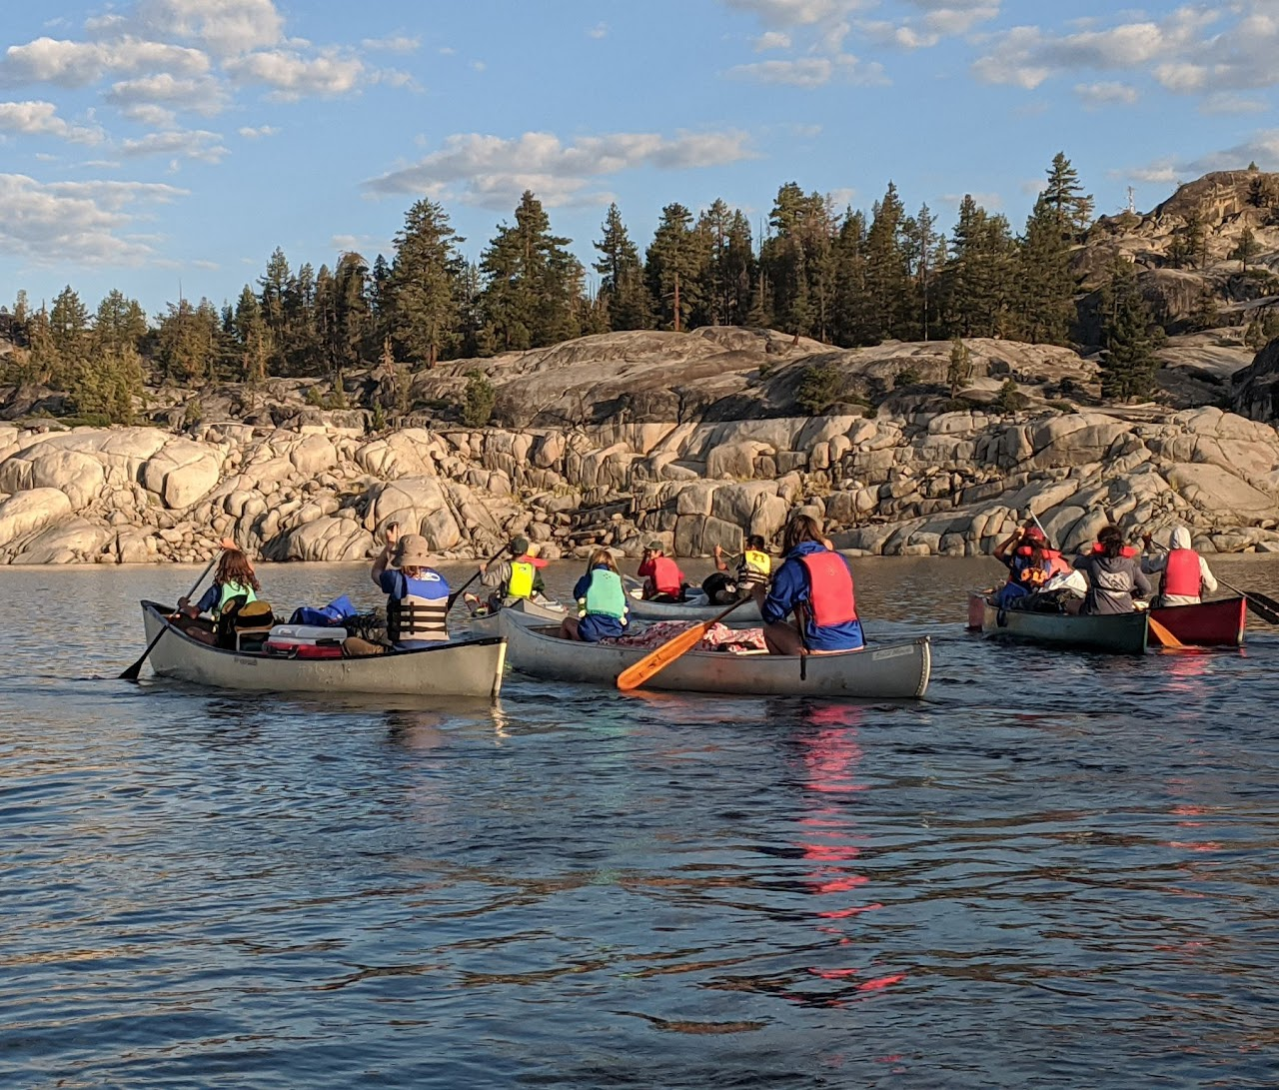
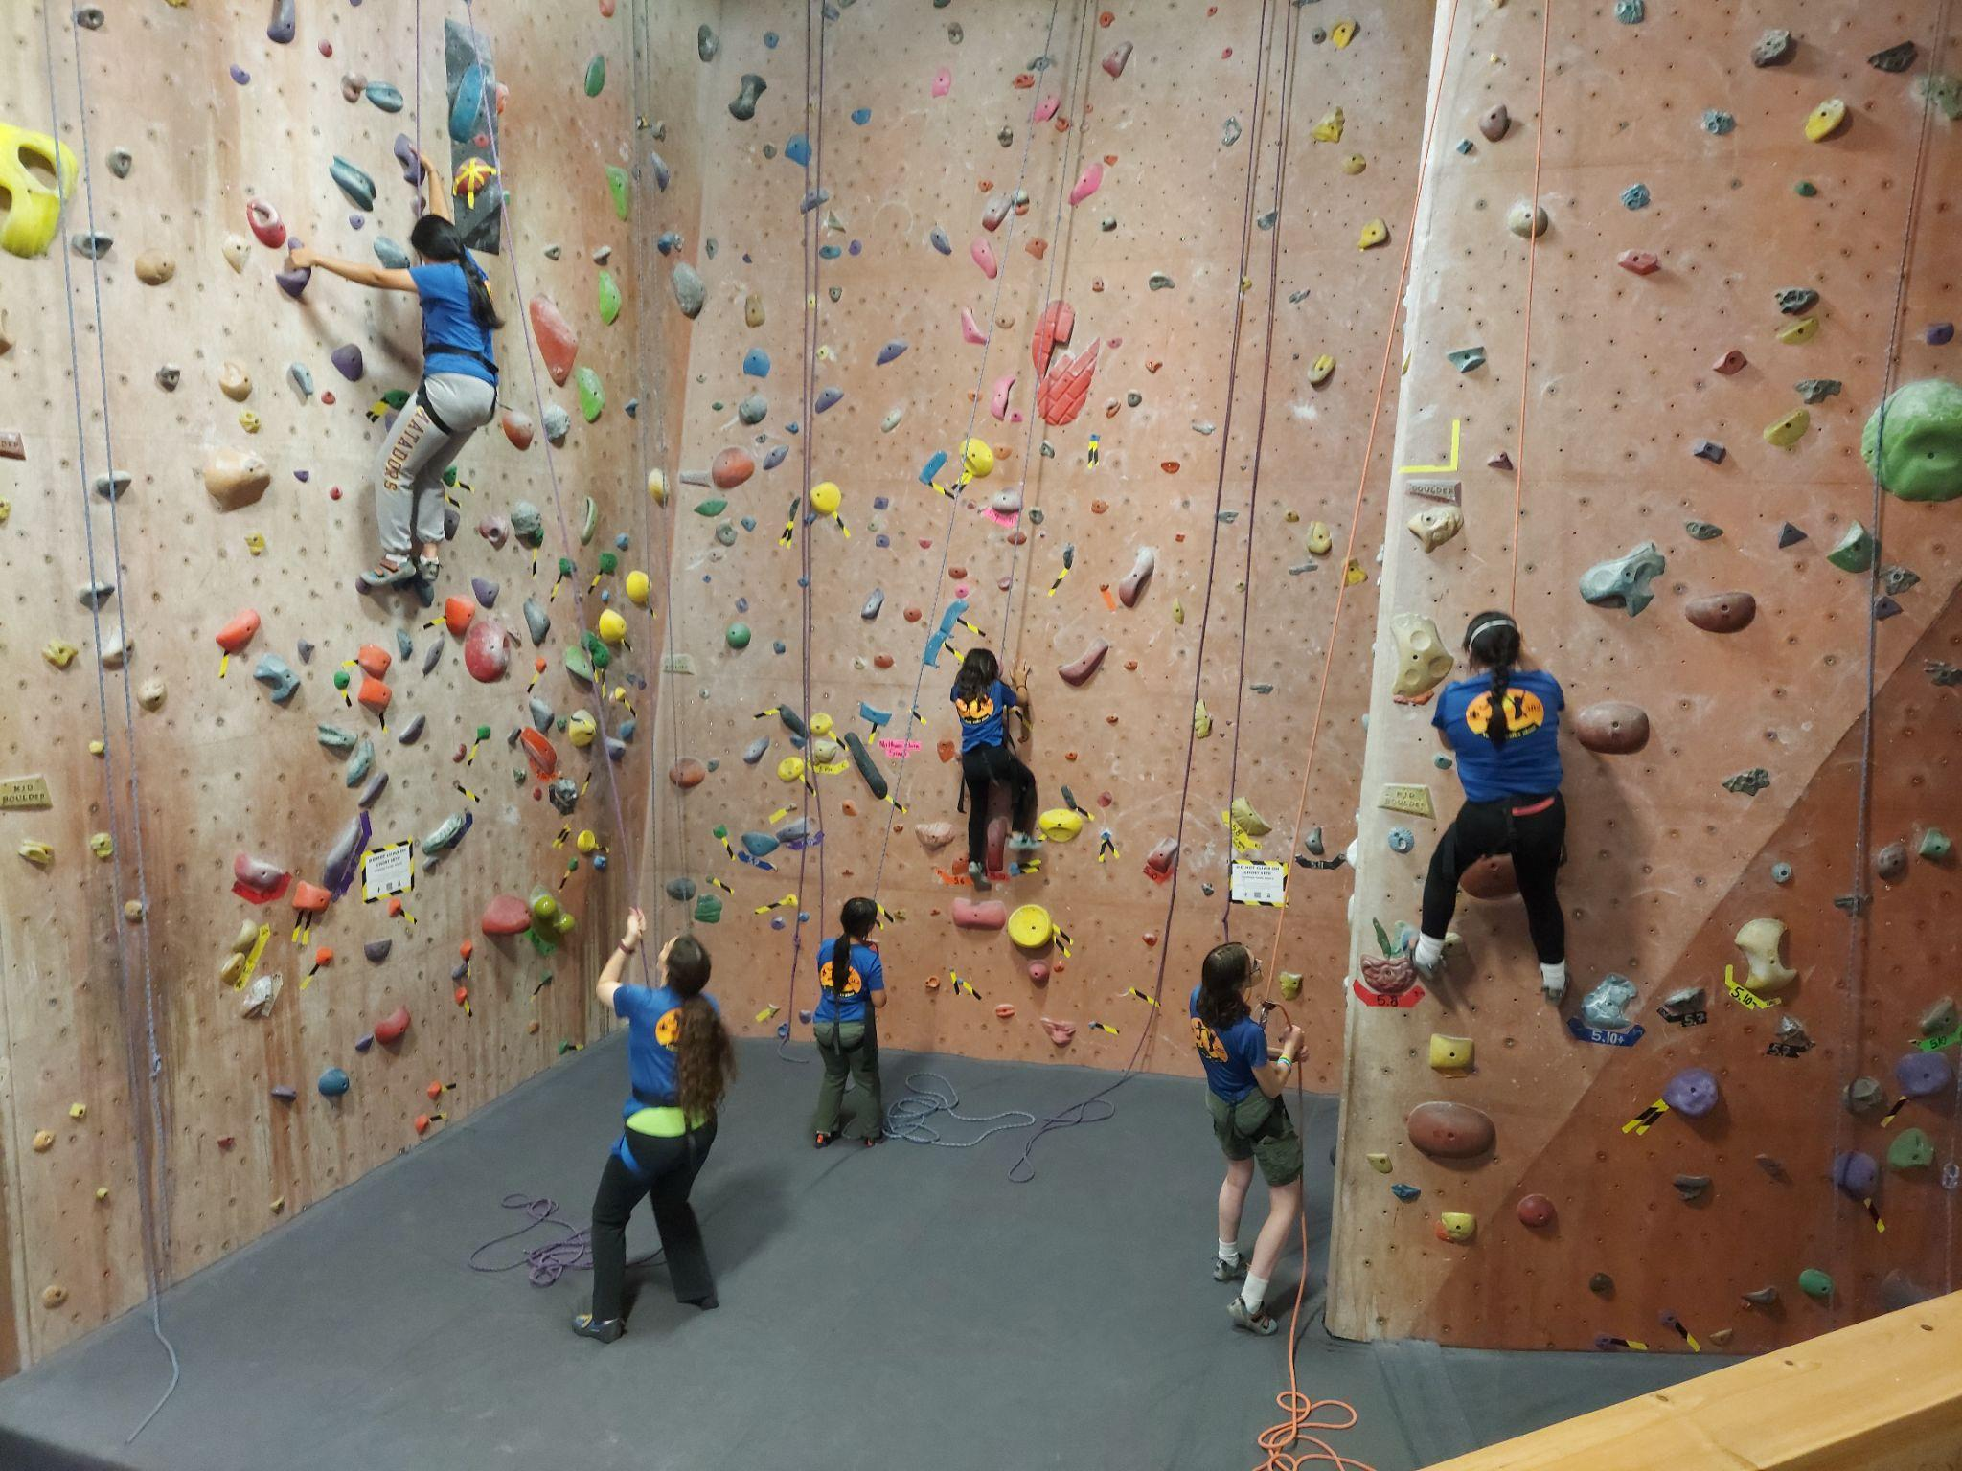
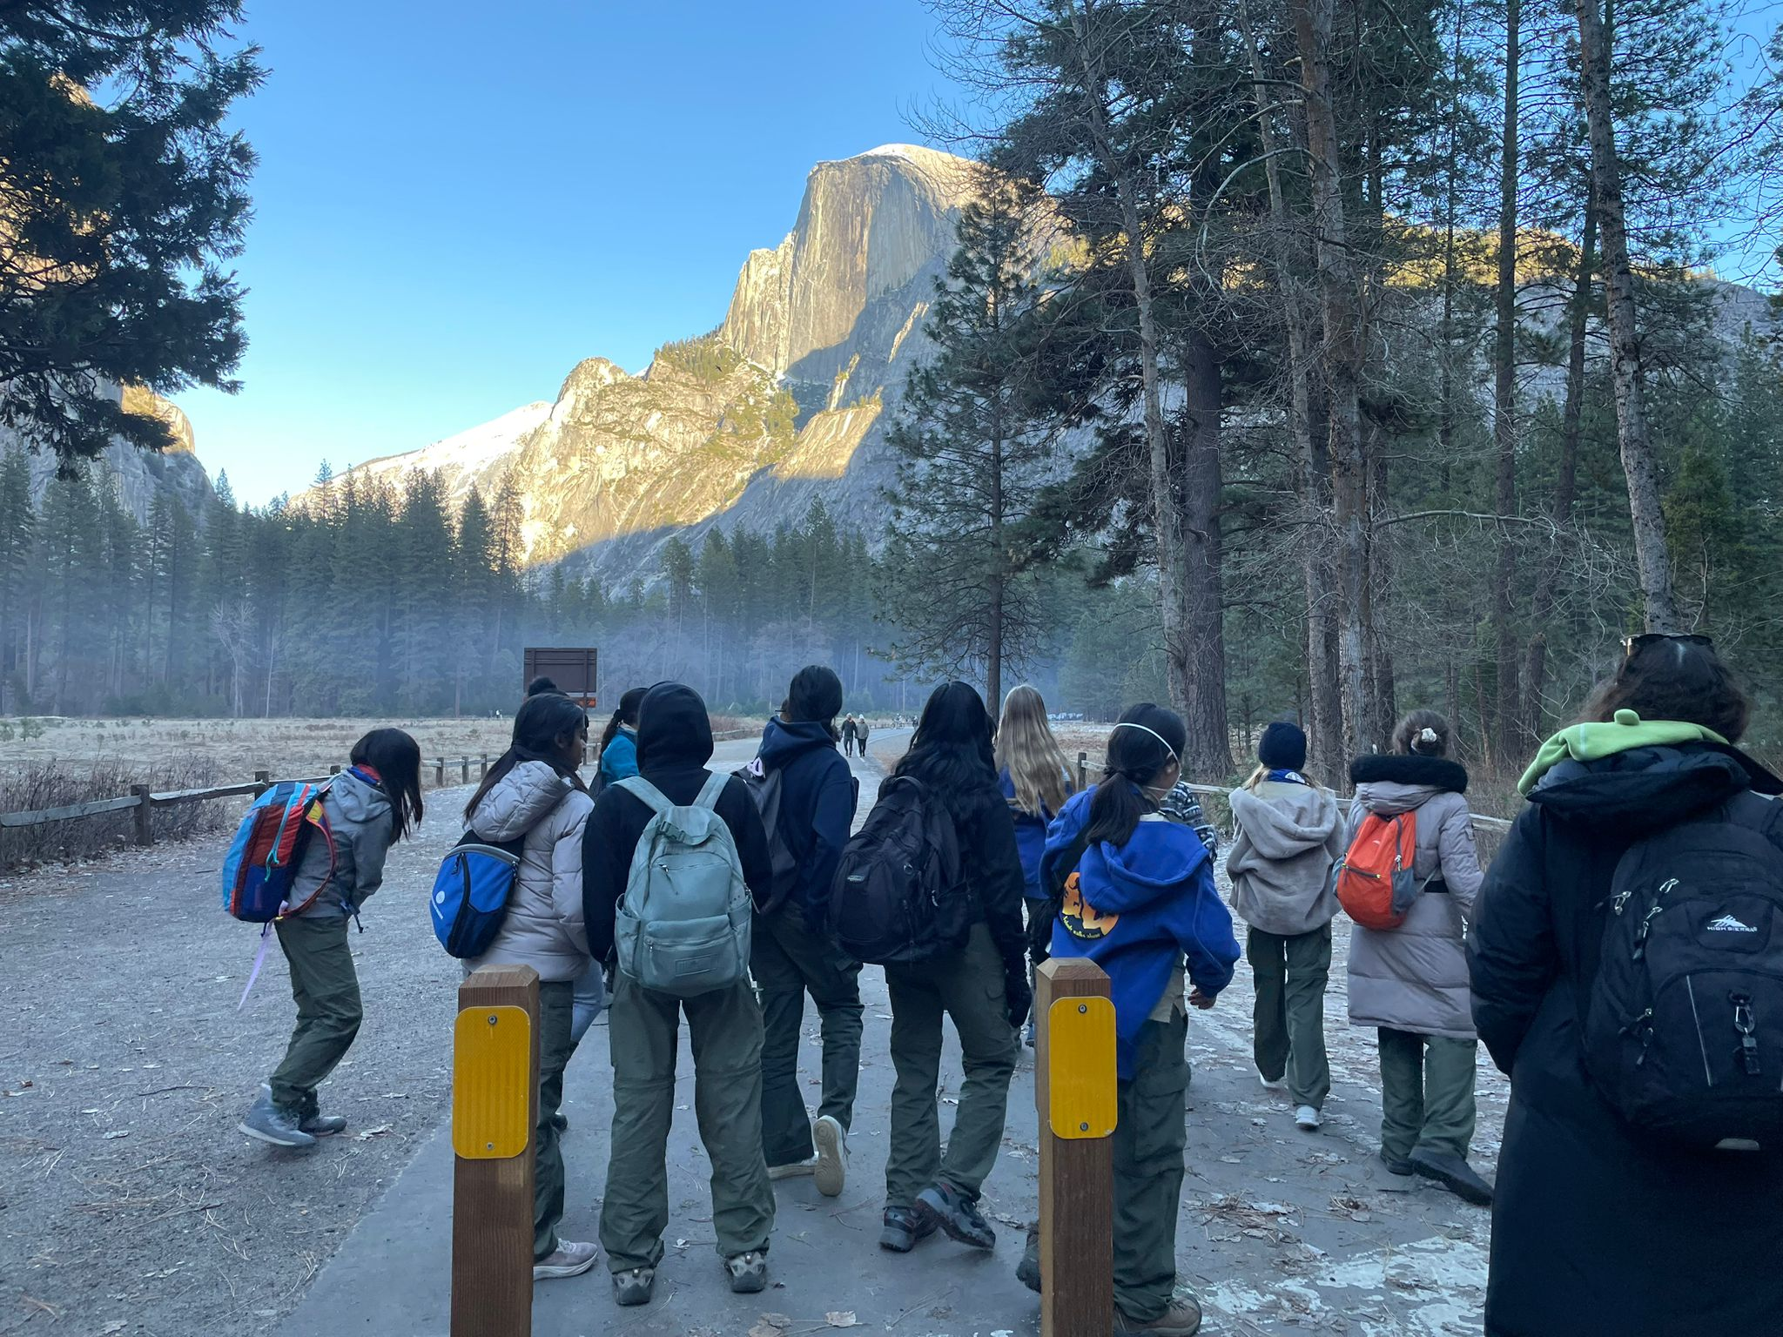
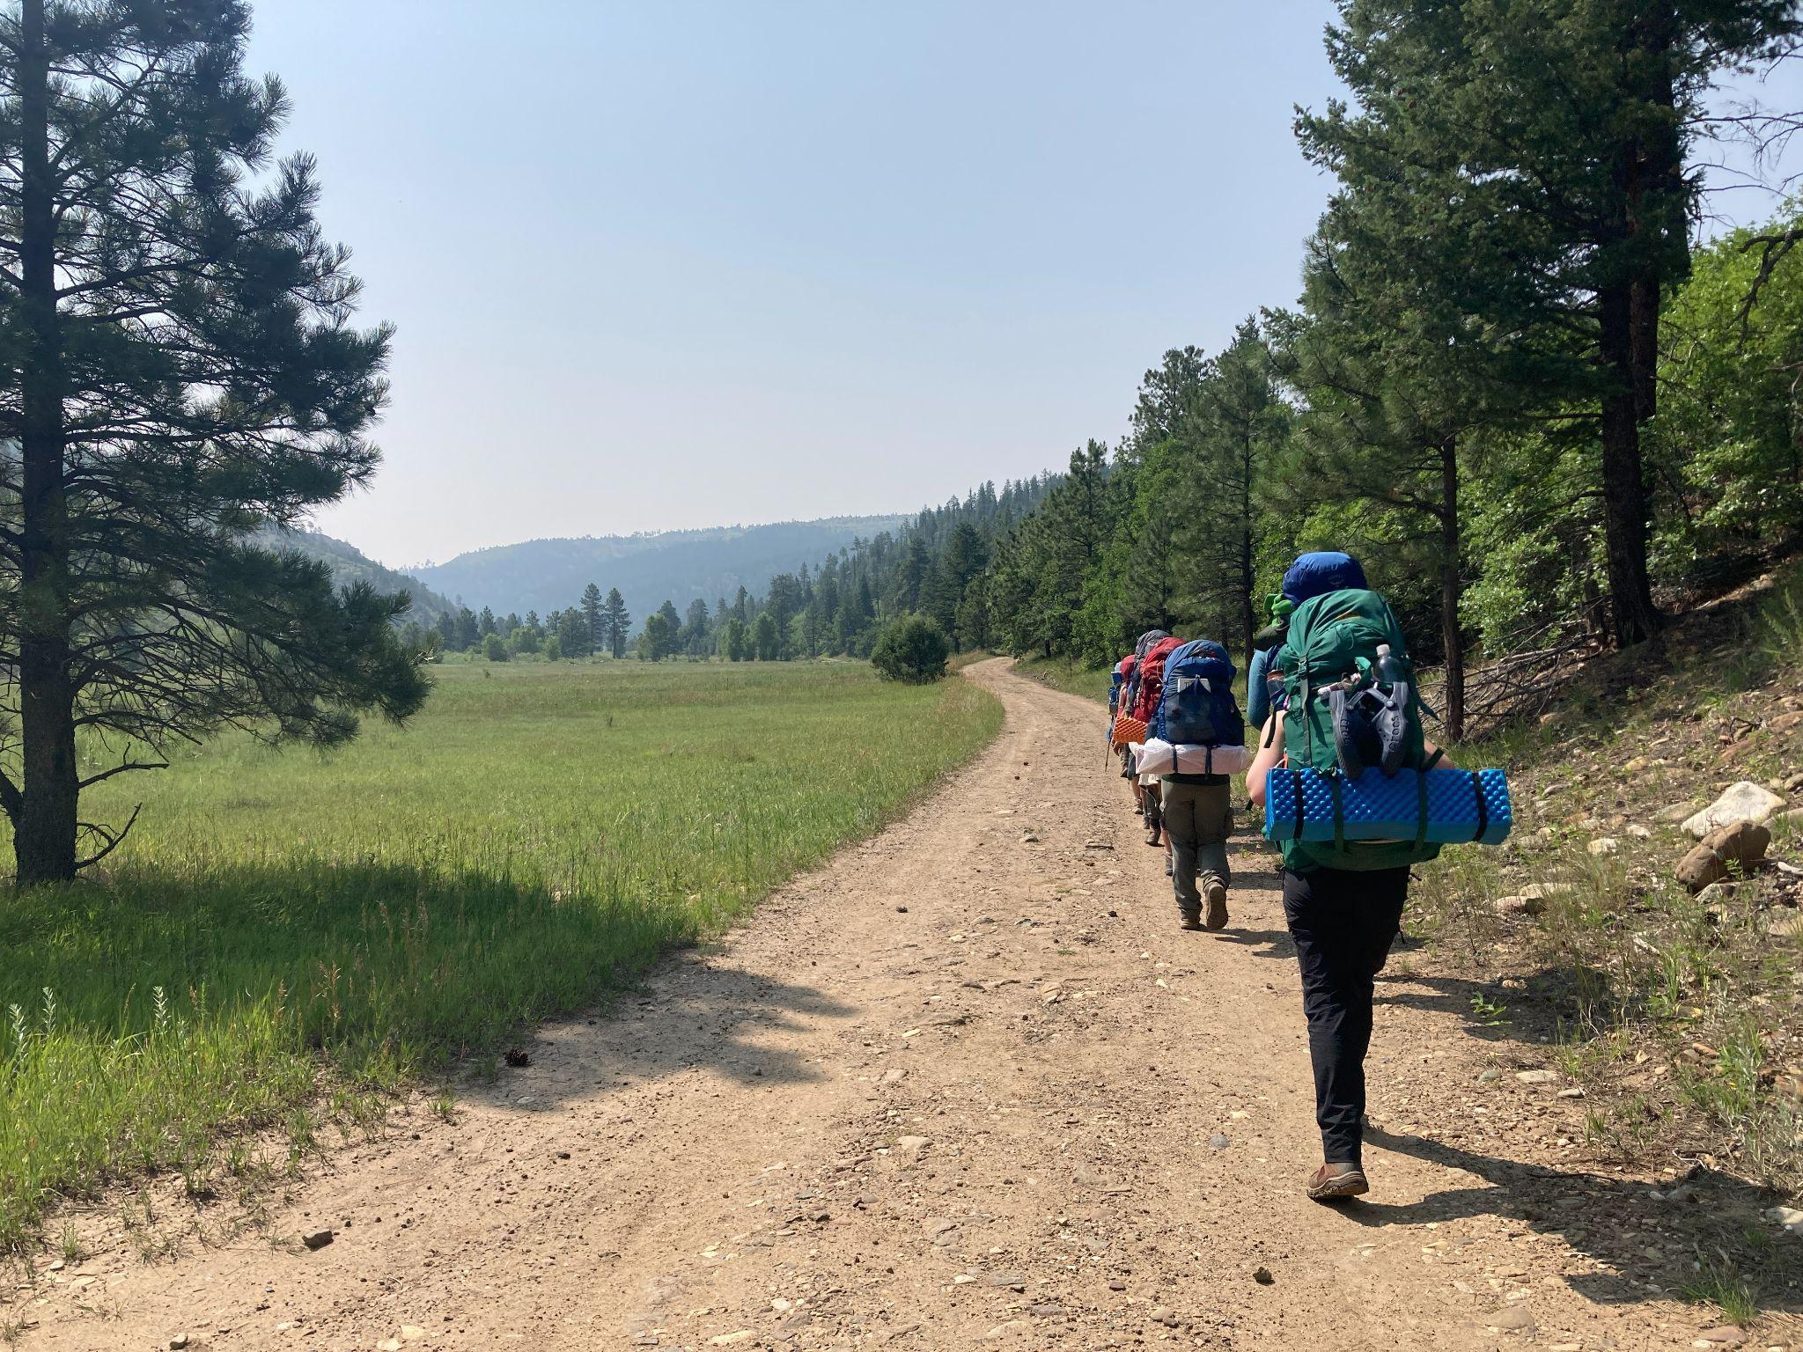
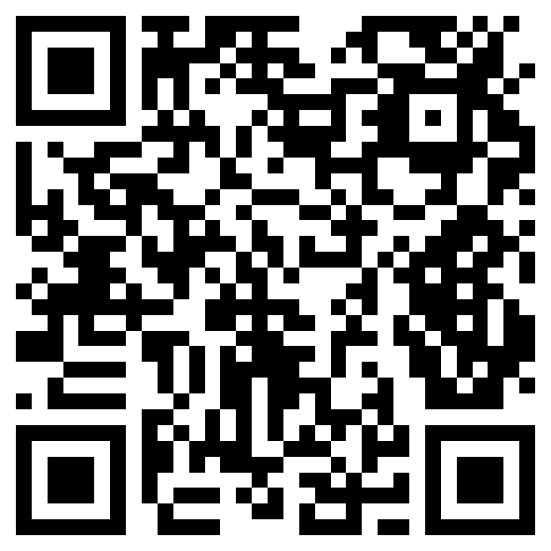
Join Troop 582!
Scouts BSA Troop 582 is a large, diverse, very active, scout-led troop based in Saratoga, CA. It is our goal to help each scout grow into an independent and strong young person.
We are an outdoor activities club for girls ages 11 through 17, with opportunities for recognition and advancement through learning and practicing the tenets of the Scout Oath and Law.
T582 scouts gain experience in practical life skills, outdoor adventure, environmental stewardship, community service, and youth leadership.
Recent activities:
Backcountry canoe camping
Backpacking– Black Mountain, Yosemite, & Philmont
Archery Campout
Snow Camping
Northern Tier Canoeing
Camp Chawanakee and Hi-Sierra
Rock Climbing: Ice Skating
Seabase Sailing + Snorkeling
Angel Island camping
Key facts:
60+ active scouts
20+ trained adult leaders
2 summer camps & 2 high adventure trips annually
25+ outings planned in 2026
25+ Eagle Scouts since troop began 6 years ago
Contact us to learn more!
Troop582.org
Scoutmaster Jessica Ollmann
info@troop582.org
(650) 224-7653

